Slide 1
Hospital Management System
Databases course
Realizado por:
Luís Seco, 2020211927

Slide 2
Index
Objectives
The ER diagram
How to run the software
Endpoints implemented
Conclusion

Slide 3
Objectives
In this project our goal was to develop a database application
For that, we started by creating the entity-relationship data model for the hospital management system
After this we developed our application with the help of a rest API that allows the user to send HTTP requests to the web server, that will retrieve or send data do the database and then send a HTTP response to the user.

Slide 4
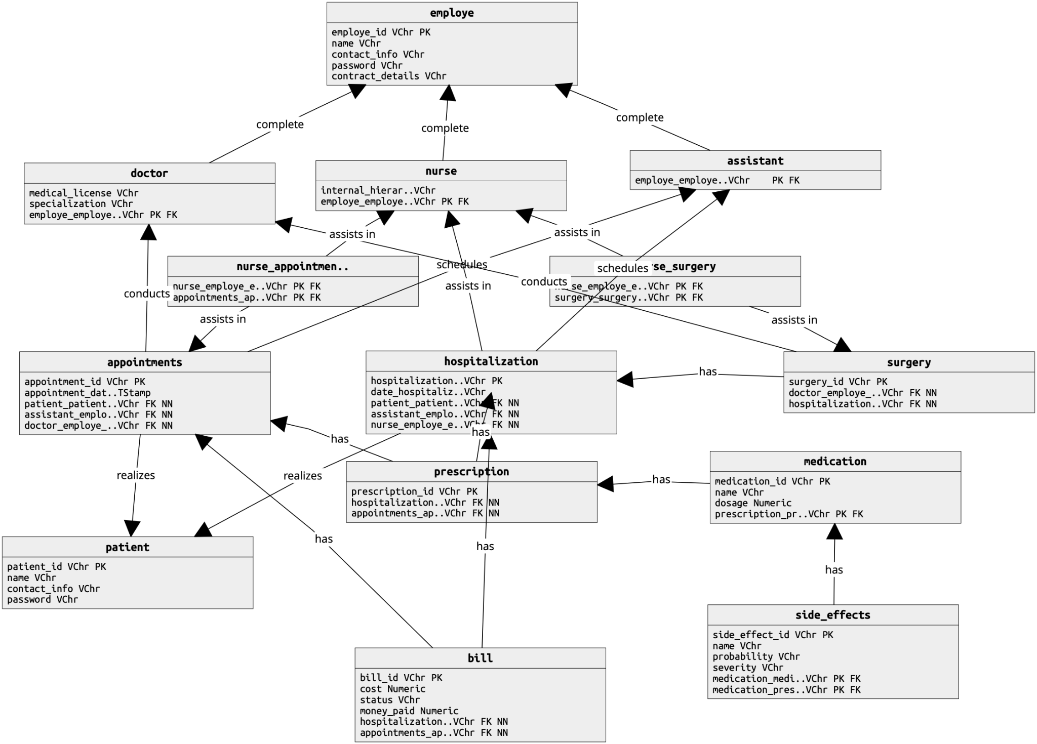
ER Diagram

Slide 5
How to run the software
To run the software the user needs to have the most recent version of python and pipenv installed.
To run the application the user should go to the app directory and run the command python -m flask run -p 5050.
To migrate the database run the scripts directly in psql with the \i <path> command.

Slide 6
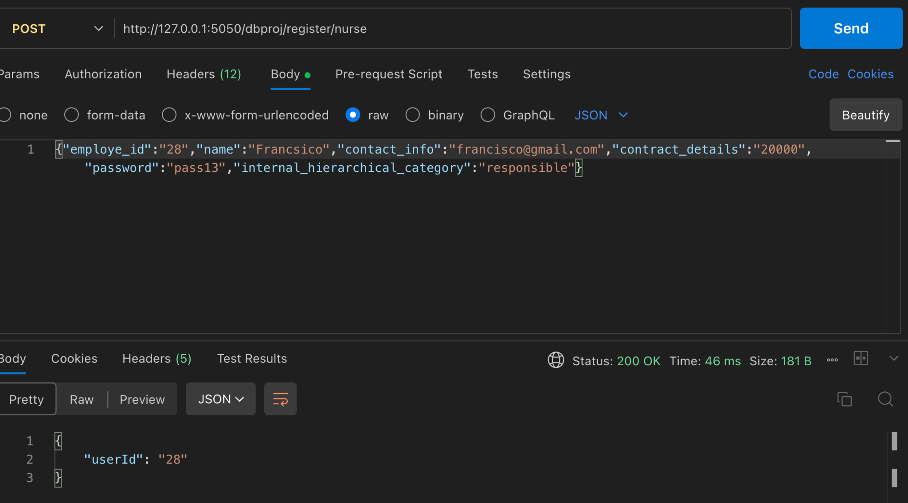
Endpoints implemented - Create nurse

Slide 7
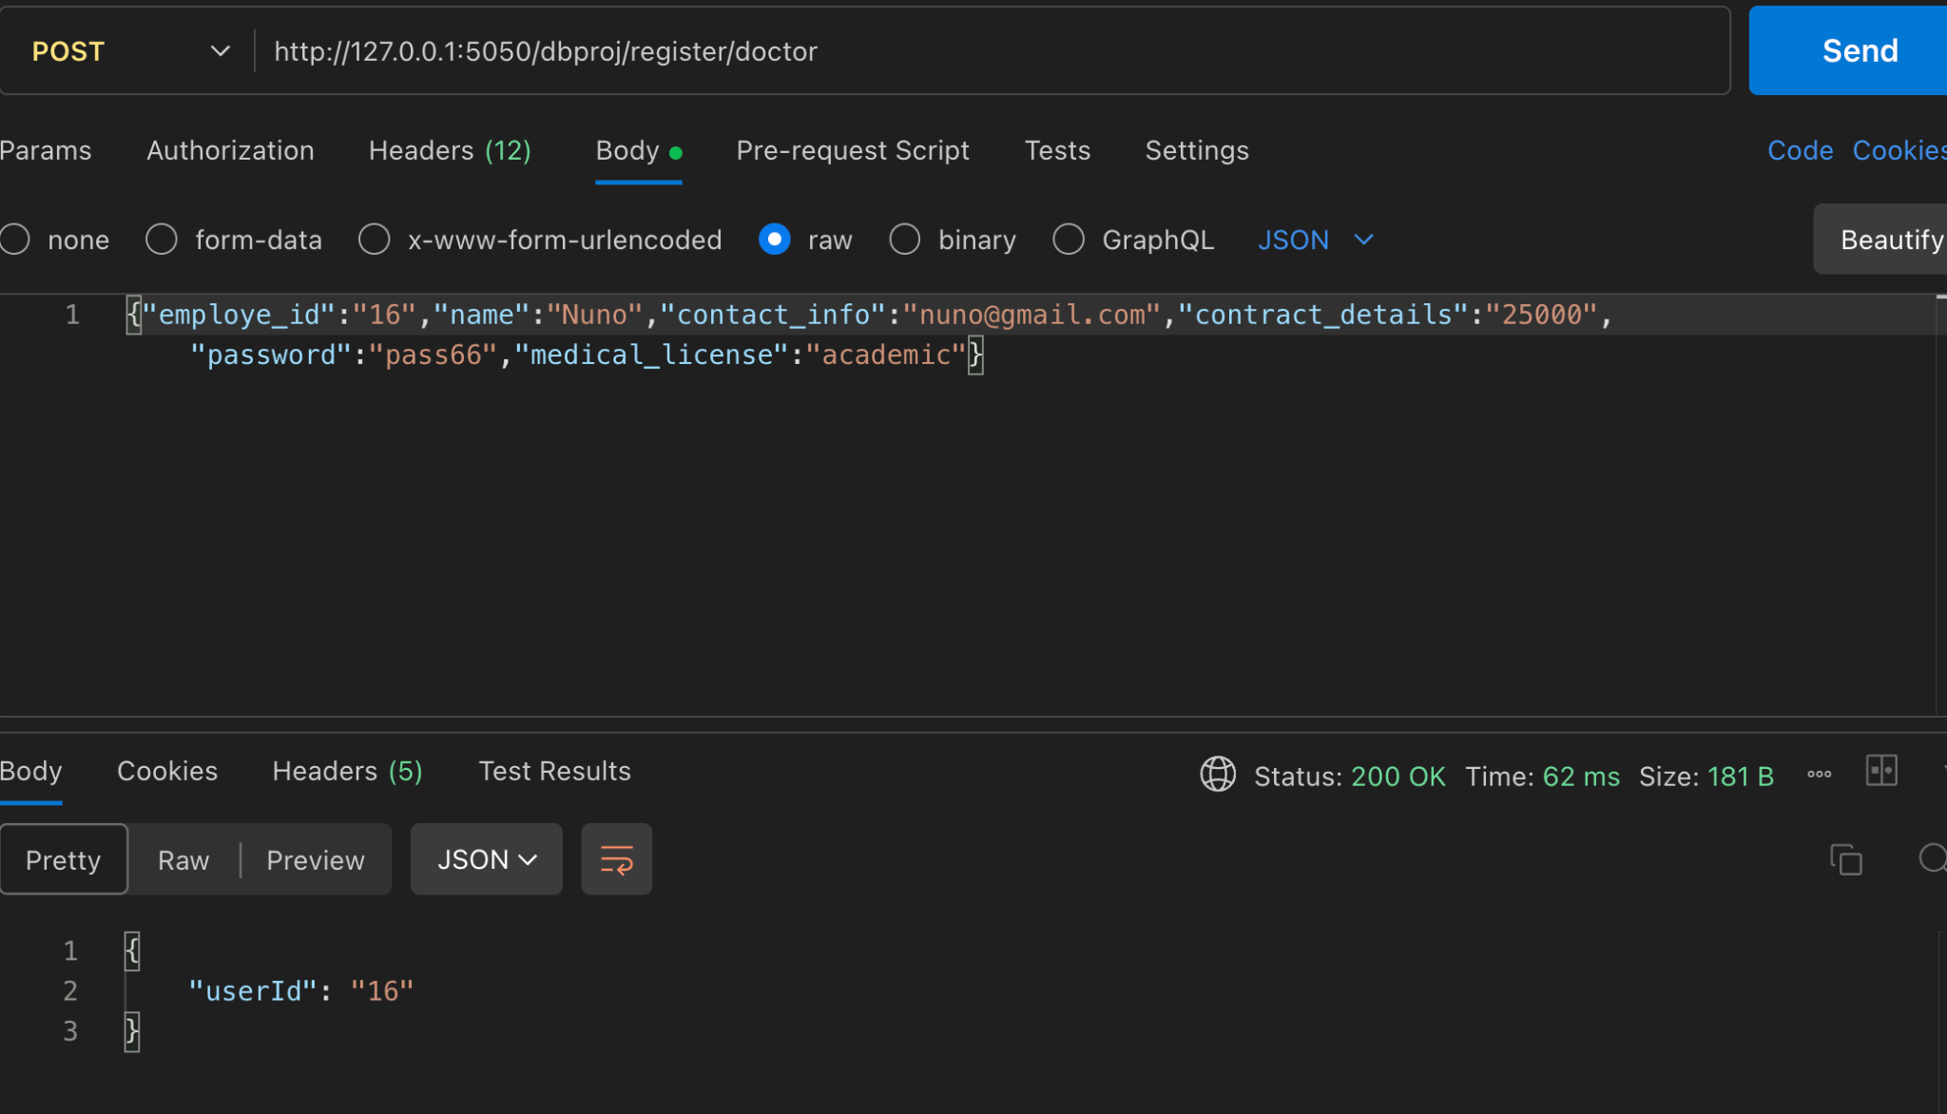
Endpoints implemented - Create doctor

Slide 8
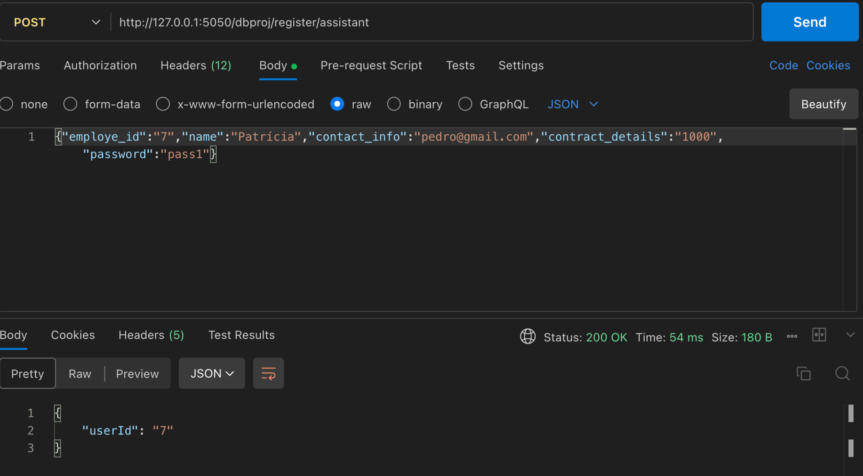
Endpoints implemented - Create assistant

Slide 9
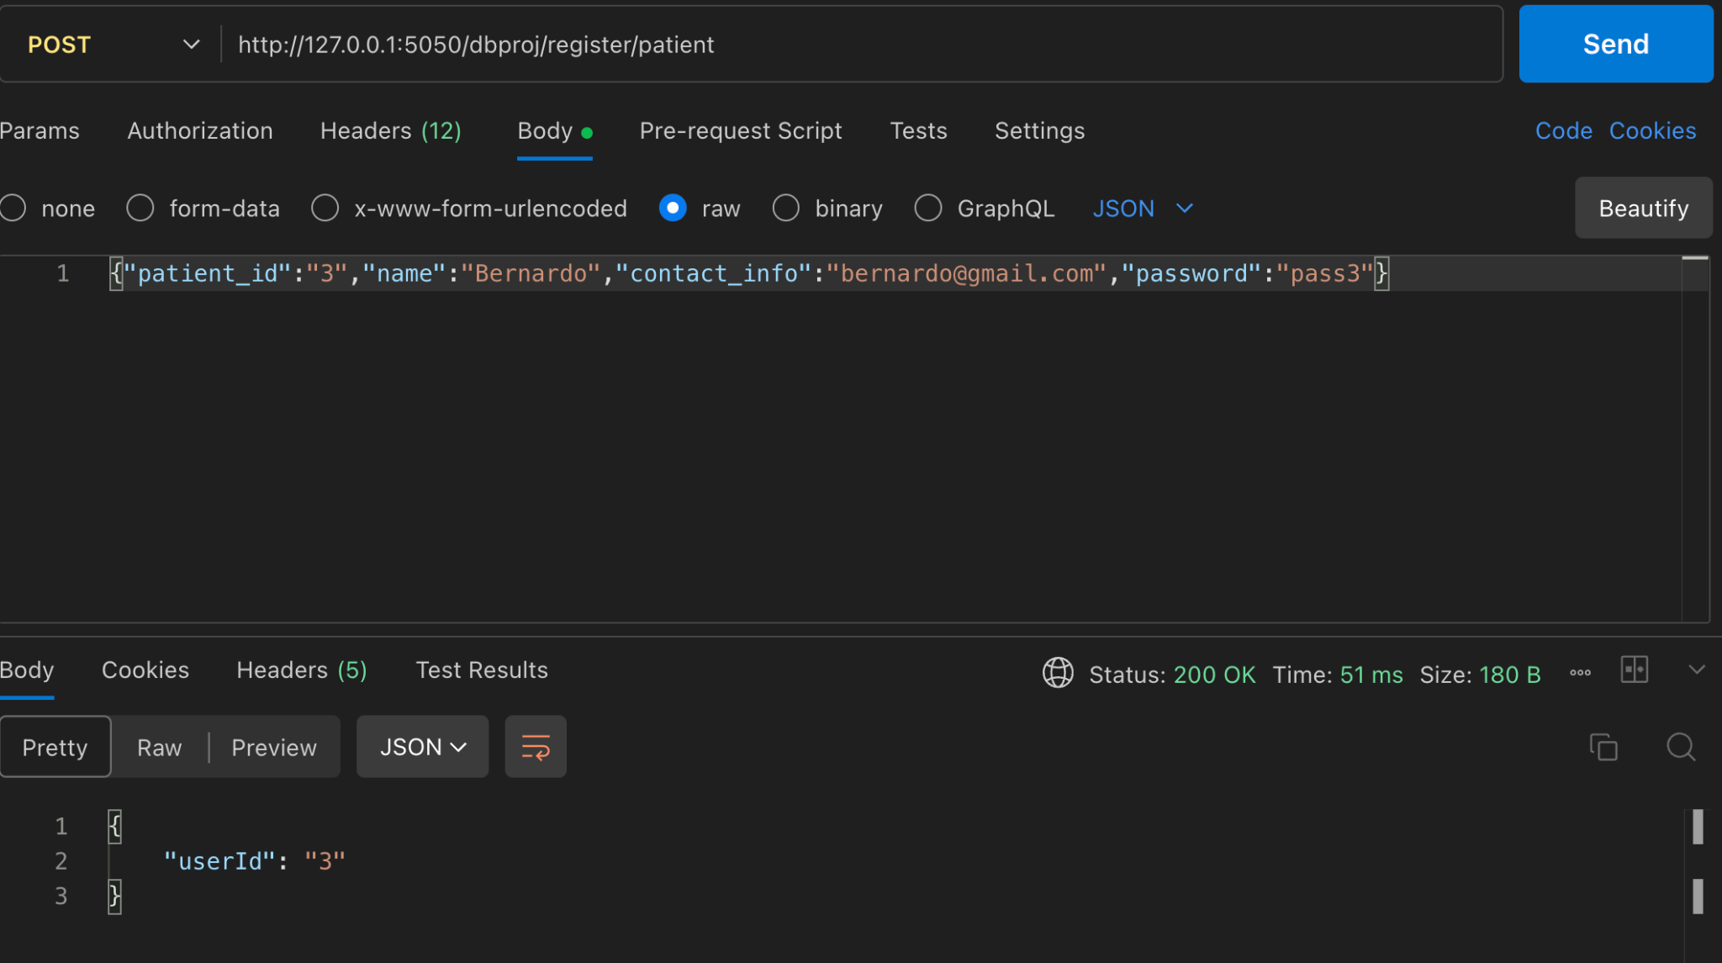
Endpoints implemented - Create patient

Slide 10
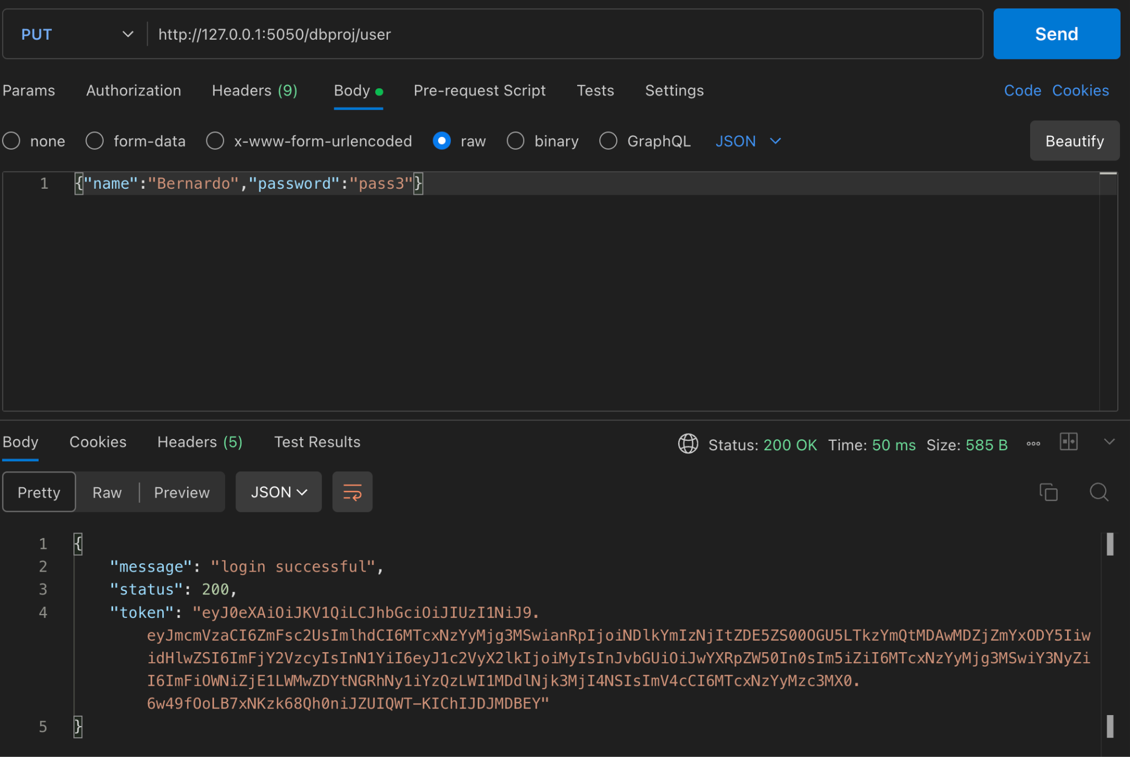
Endpoints implemented - Login

Slide 11
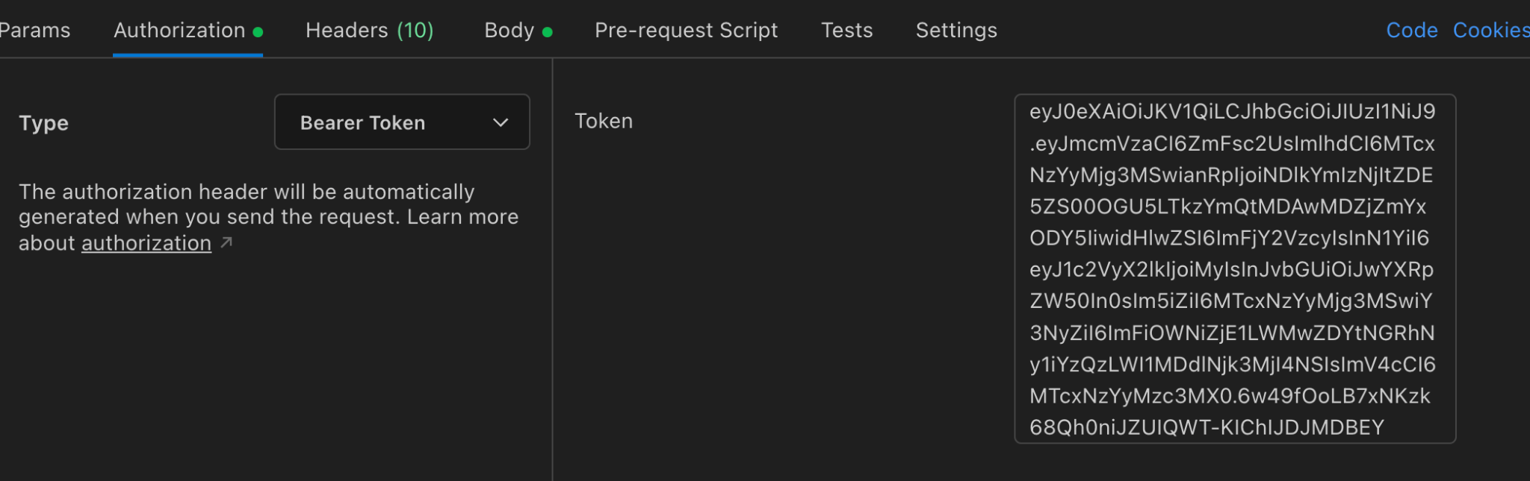
Endpoints implemented - User token

Slide 12
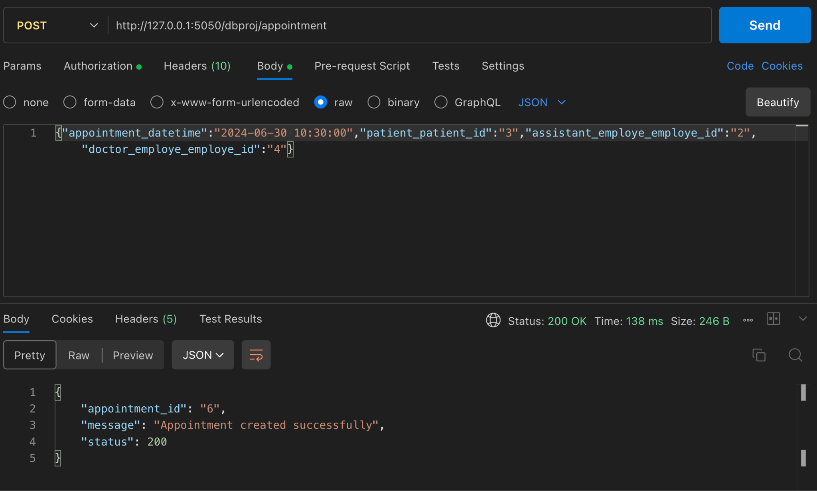
Endpoints implemented - Create appointment

Slide 13
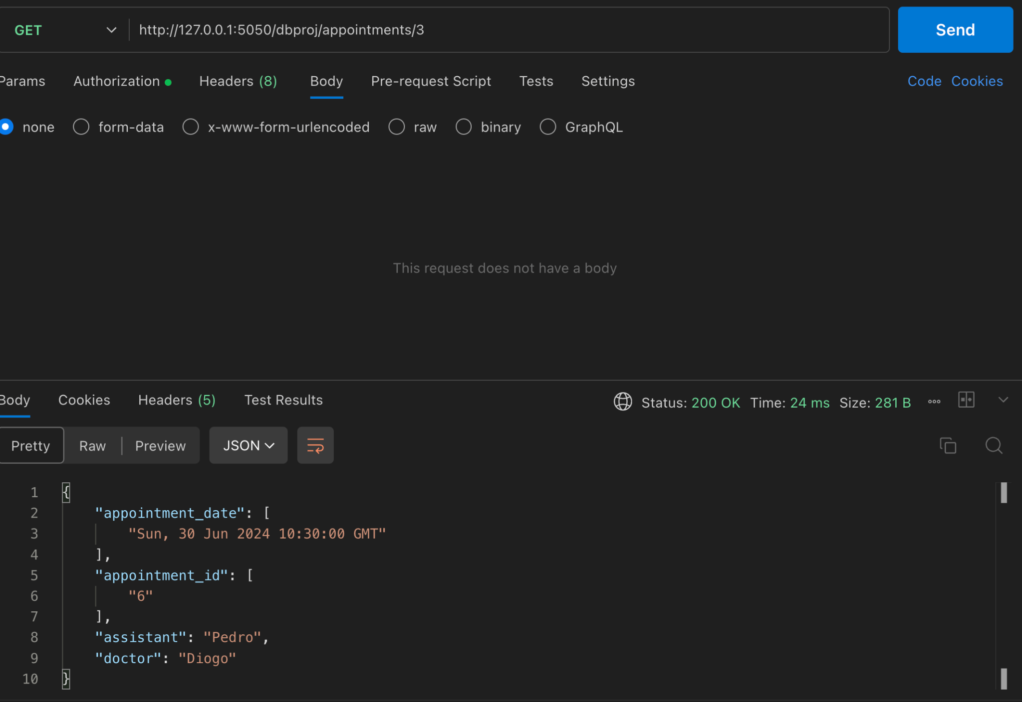
Endpoints implemented - Get appointment

Slide 14
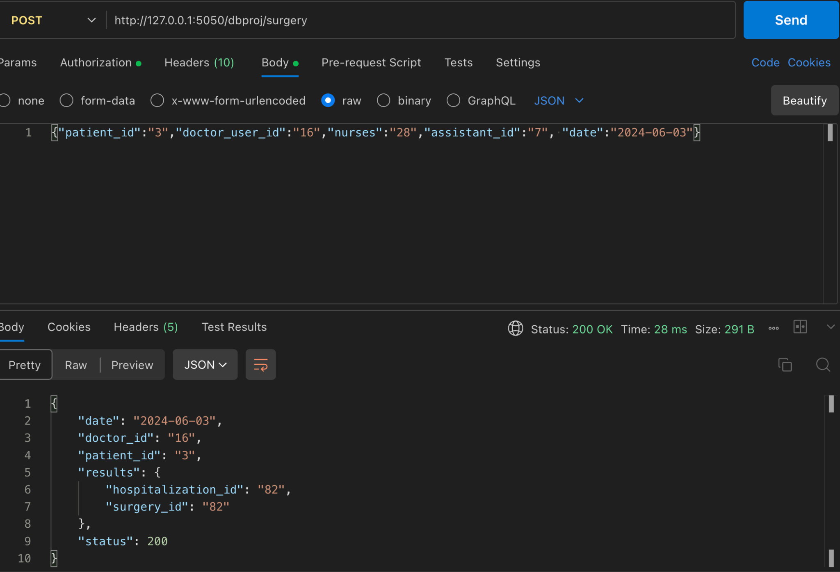
Endpoints implemented - Schedule surgery

Slide 15
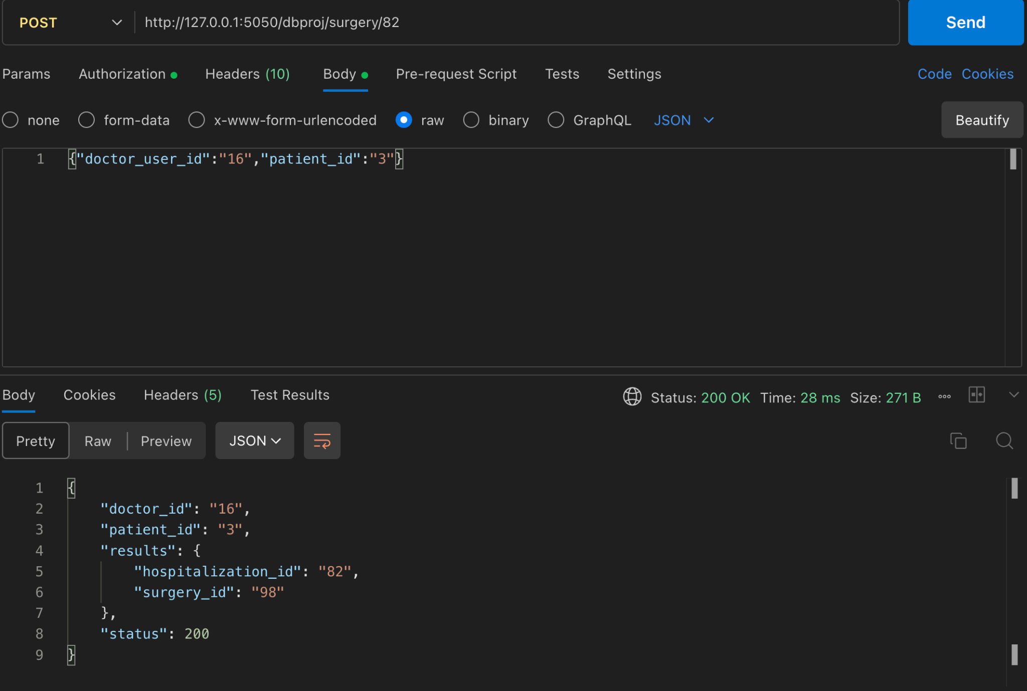
Endpoints implemented - Schedule surgery in hospitalization

Slide 16
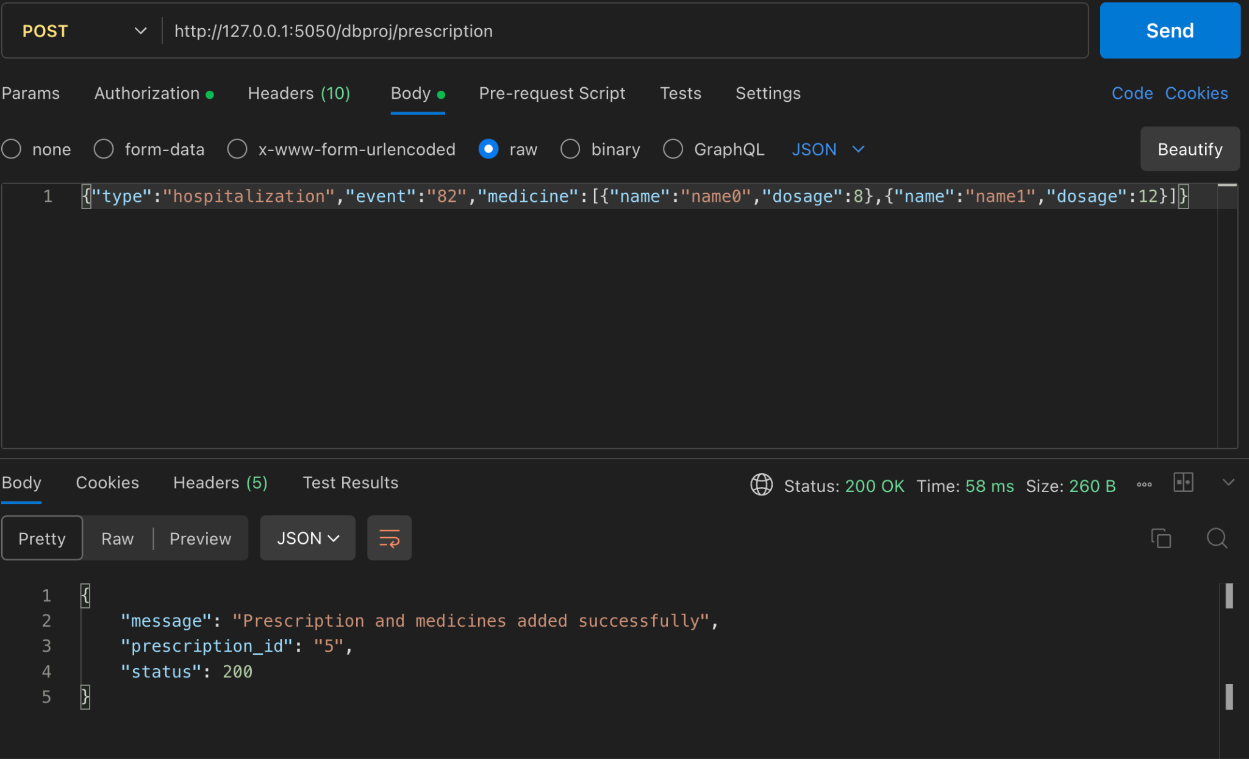
Endpoints implemented - Add prescription

Slide 17
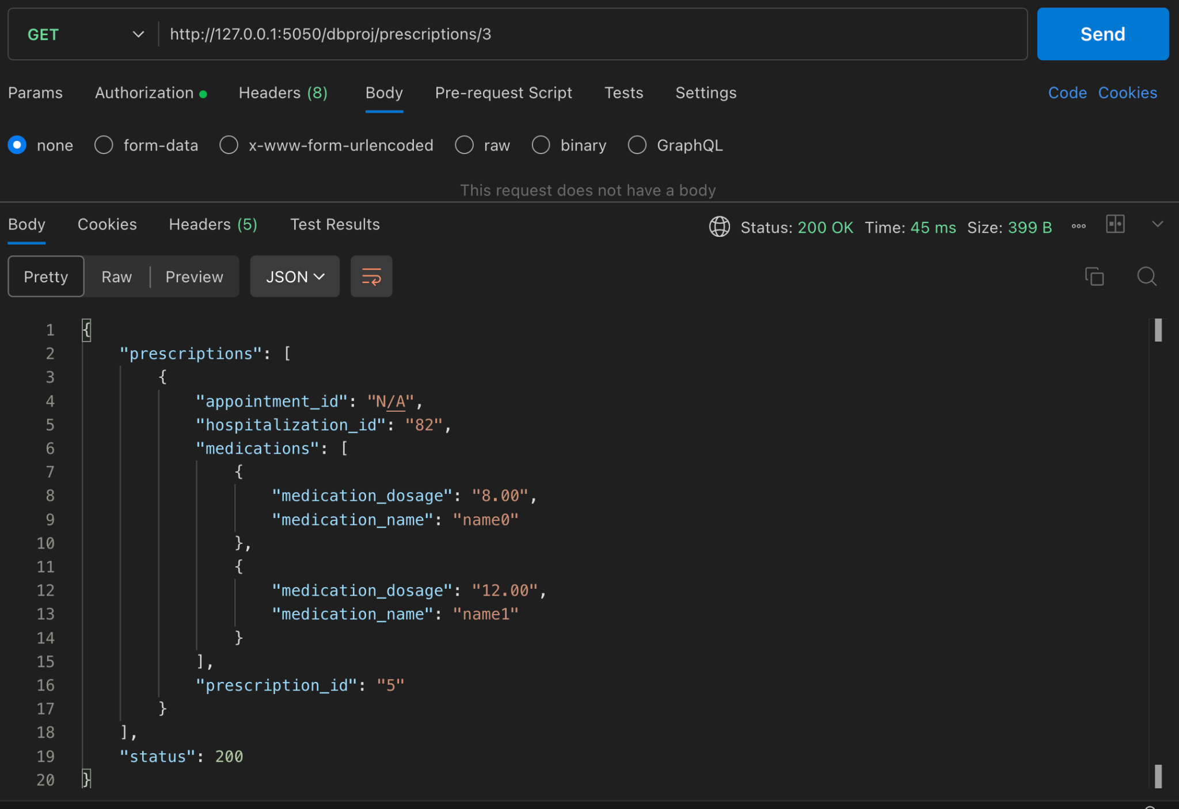
Endpoints implemented - Get prescriptions

Slide 18
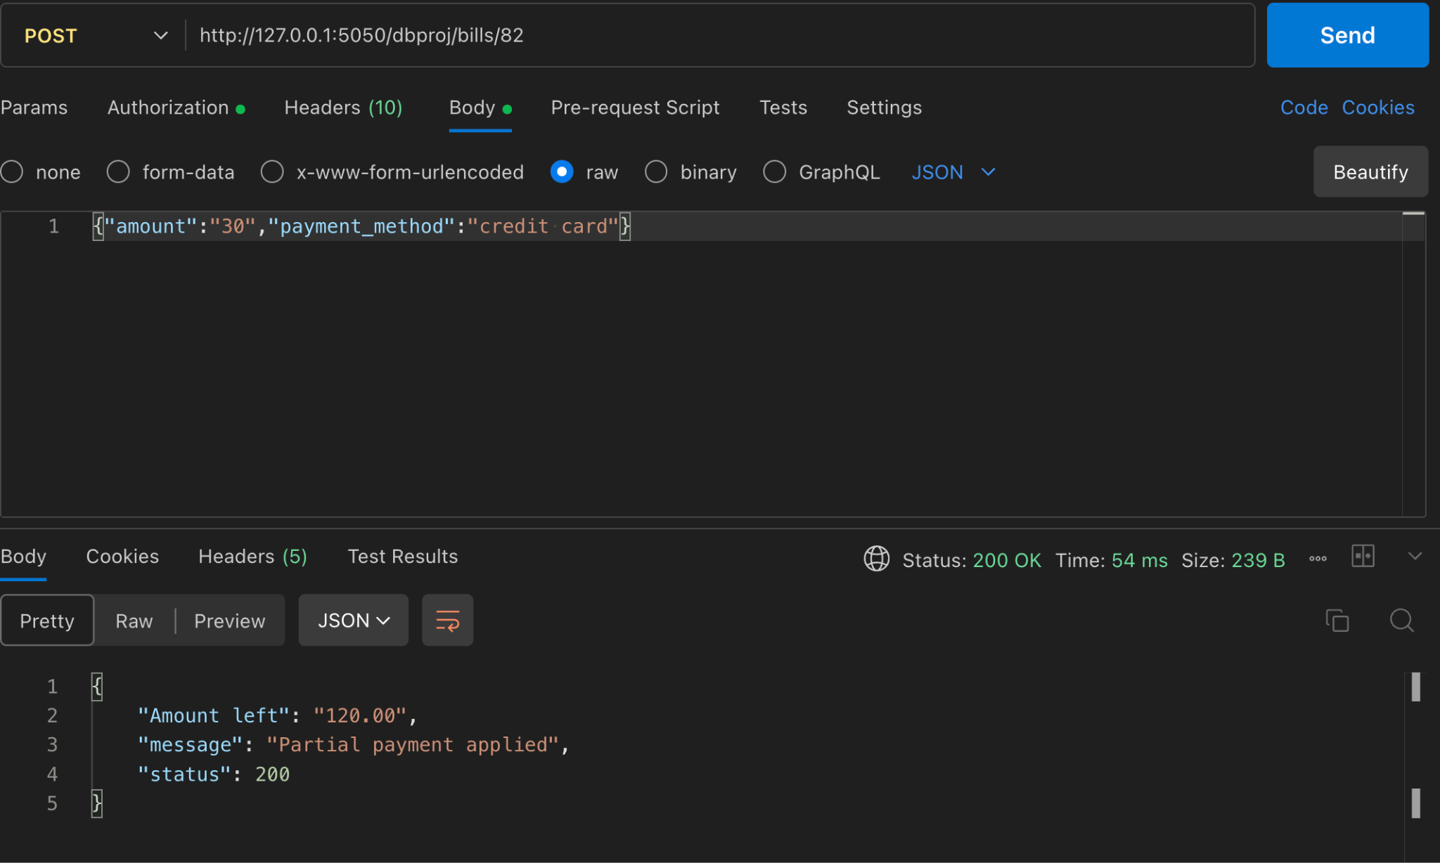
Endpoints implemented - Execute payment

Slide 19
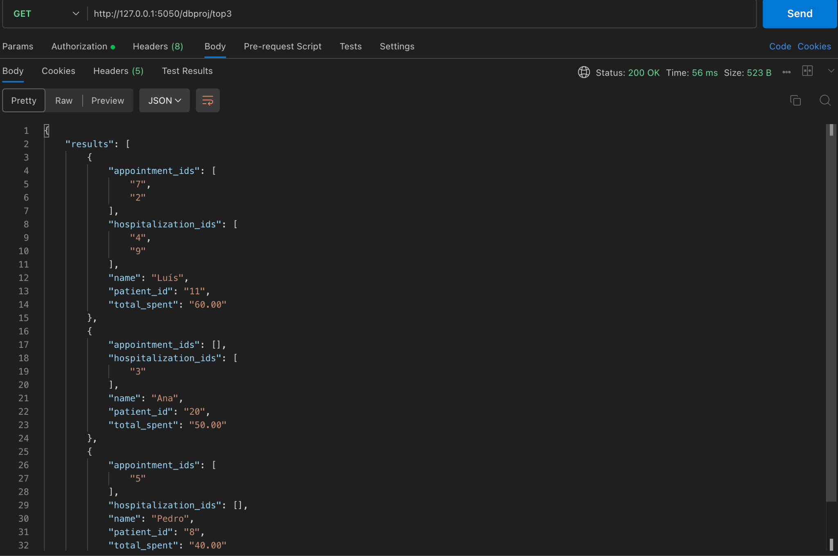
Endpoints implemented - Top 3 clients

Slide 20
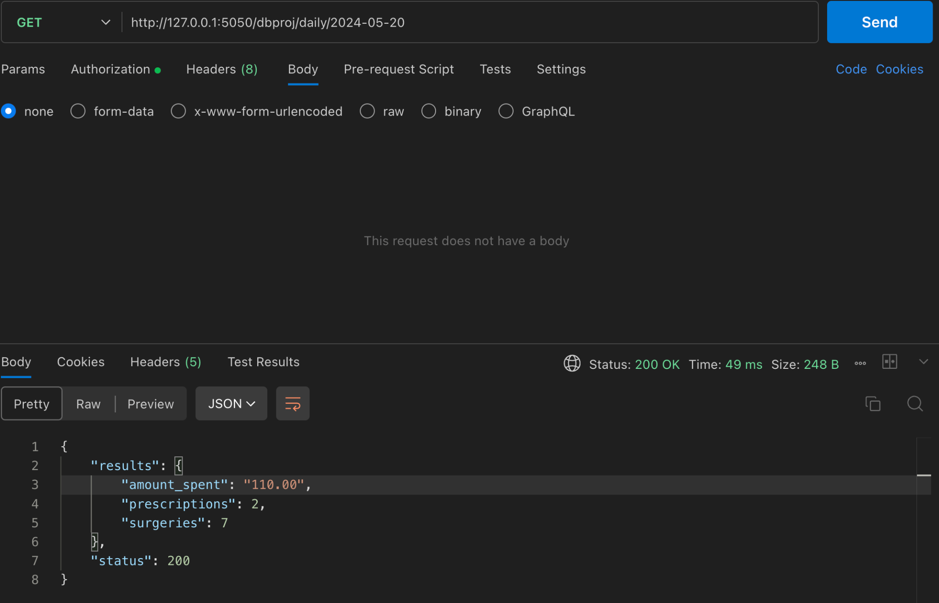
Endpoints implemented - Daily summary

Slide 21
Conclusion
After the development of this project, I understood the importance of the ER model for a well structured database.
The importance of API’s(Postman) to obtain data
Better understanding in writing complex queries for some endpoints
Data security and how big of a role it plays in database systems

